Slide 1
Parallel Graph Coloring Algorithms
Jeff Flower

Slide 2
Some Motivation
Explore Parallel Graph coloring problem
How do we go from a sequential graph coloring algorithm to a parallel graph coloring algorithm?
Use what I’ve learned for further research
Stay tuned…

Slide 3
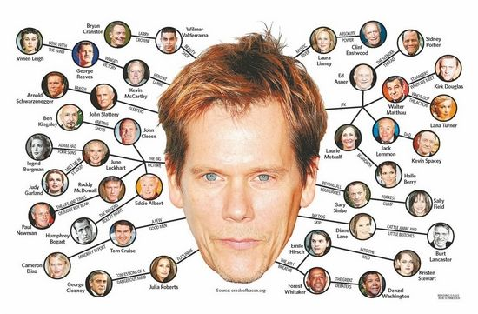
Warning: Graphic Image

Slide 4
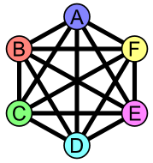
Another Graph

Slide 5
Graph Theory – definitions
A graph G = (V, E)
V is a set of vertices
E is a set of edges
Edge is defined by two vertices
|V(G)| = number of vertices (cardinality of vertex set)
|E(G)| = number of edges (cardinality of edge set)
[5]

Slide 6
Graph Theory – definitions cont…
vertex degree
The number of edges a vertex is an endpoint of
vertex adjacency
If 2 vertices share an edge, they are adjacent
planar graph
A graph that can be drawn on a plane with no edge crossings
[5]

Slide 7
Graph Theory – last definition slide, I promise
Describing our second graph in the terms that we just discussed
V(G) = {A, B, C, D, E, F}
E(G) = {AB, AC, AD, AE, AF, BC,…,EF}
|V(G)| = 6
|E(G)| = 15
Degree of A = 5
A is adjacent to B, C, D, E, F
Not planar

Slide 8
Graph Coloring
Graph coloring is the assignment of colors to each vertex
Labelling the vertices with a color name
A proper vertex coloring assigns colors to vertices such that no adjacent vertices use the same color
[5]

Slide 9
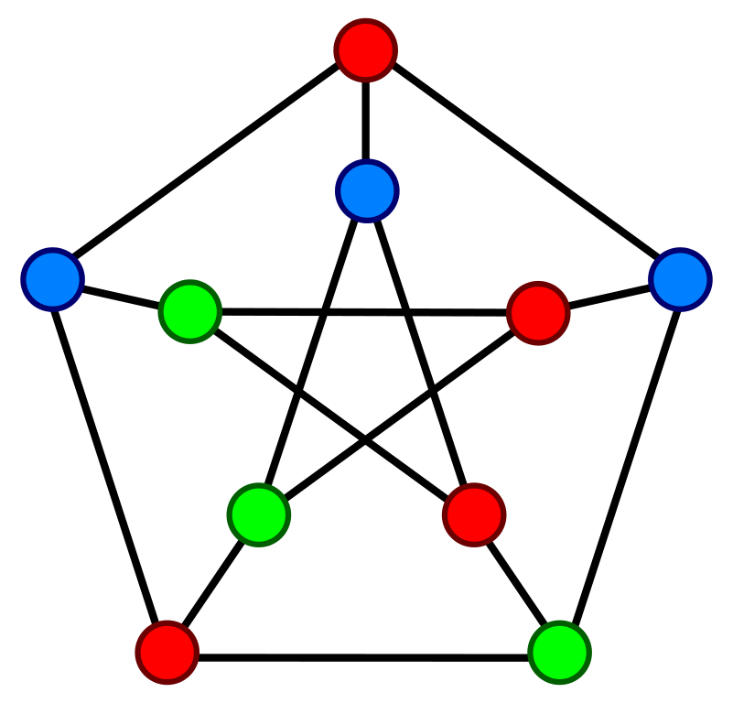
Graph Coloring

Slide 10
Graph Coloring cont..
Chromatic Number:
The minimum number of colors needed to properly color a graph [5]
The previous slide shows a 3-coloring of the graph
Any planar graph needs at most 4 colors

Slide 11
Graph Coloring – surprisingly useful
Some Graph Coloring Applications I’ve come across:
Job Scheduling
VLSI chip design
Solving partial differential equations

Slide 12
Graph Coloring Algorithms
Algorithmically coloring a graph in the fewest possible colors would mean considering all possible permutations of vertices and colors
k^{n} time using k colors and n vertices
Not practical for all but the smallest graphs
Proven NP-Hard [3]

Slide 13
Sequential Greedy Coloring
G = (V,E)
V’ = V(G)
for i = 1 to |V(G)| do in sequence
assign a vertex from V’ to v
assign the smallest available color to v
V’ = V’ - v
end do
[2]

Slide 14
Sequential Greedy Coloring
Observations:
Order in which you visit vertices is key
Finding an optimal vertex ordering: also NP-Hard

Slide 15
Parallel Graph Coloring
To parallelize graph coloring, we need to find operations that can be done independently of each other
One approach uses independence sets [1]
Independence Set:
A set of vertices such that no member of the set is adjacent to any other member (no edge between any two members of the set)

Slide 16
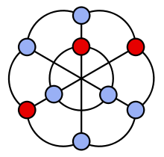
The red vertices are independent

Slide 17
Parallel Graph Coloring
Maximal Independence Set (MIS):
Largest possible independence set in a graph
How can we use this?
Since no members of the set are adjacent, it’s safe to color each member of the set at the same time

Slide 18
Parallel Coloring with Independence Sets
General Outline for coloring with Independence Sets
V’ := V
while ( |V’| > 0 ) do in parallel
Choose an independent set I from V’
Color all vertices in I
V’ := V’ - I
end do
[2]

Slide 19
Luby’s MIS Algorithm
Michael Luby proposed a parallel SIMD algorithm which found a maximal independent set for parallel coloring (1986) [1]
G = (V,E)
I = empty set
V’ = V(E)
while G’ not empty do
select a set I’ from V’, which is independent
I = I + I’
Y = I’ + all neighbors of I’
V’ = V’ – Y
end

Slide 20
Luby’s Algorithm cont…
How Luby performs the select step is the key element:
In parallel, assign a random weight to each vertex of the graph
I’ = V’
In parallel, process each edge with two members in V’:
if the weight of i > weight of j, remove i from I’
else remove j from I’

Slide 21
Luby’s Algorithm cont…
After the independent set is calculated, assign all members in the set the same color
drawbacks:
re-assignment of random weights must be globally synchronized so that comparisons in future steps are correct
Re-computation of the data structure that holds the random weights [2]

Slide 22
Jones-Plassmann
Jones-Plassmann published an improvement to Luby’s Algorithm for an MIMD model (1993) [2]
no reassignment of random vertex weights after each step
each member of the independent set is colored based on it’s neighbors values

Slide 23
Coloring by Partitioning
General drawback of the MIS approach:
Speed of the algorithm dependent on the size of the independence set you find
Gebremedhin and Manne also felt the scalability of the Luby and Jones-Plassmann was discouraging [3]
Block partitioning, proposed by Gebremedhin and Manne (2000) [3], avoids this entirely by dividing the vertex set into blocks of vertices
Randomly order the vertices
Divide the vertices into blocks of size n/p
n = total number of vertices
p = number of processors

Slide 24
Graph Partitioning – Algorithm Outline
Phase 1:
partition vertices as discussed on the last slide
Color each of the n/p vertices
Synchronization barrier at the end of each step so that graph information is up to date when we go to color the next vertex
Phase 2:
Possible there are adjacent vertices using the same color, each processor sequentially scans it’s vertices and registers any conflicts
Phase 3:
Sequentially fix the conflicts

Slide 25
An Open Research Problem: The Chromatic Number of Thickness Two Graphs
Thickness Two Graph: A graph that can be broken in to two, planar drawings
Currently the largest possible chromatic number of a graph is between 9 and 12 inclusive [4]
My motivation is to find a programmatic way to color a graph that could increase the bound from 9 to 10

Slide 26
Questions?

Slide 27
References
[1]M. Luby, 'A Simple Parallel Algorithm for the Maximal Independent Set Problem', SIAM J. Comput., vol. 15, no. 4, pp. 1036-1053, 1986.
[2]M. Jones and P. Plassmann, 'A Parallel Graph Coloring Heuristic', SIAM J. Sci. Comput., vol. 14, no. 3, pp. 654-669, 1993.
[3]A. Gebremedhin and F. Manne, 'Scalable parallel graph coloring algorithms', Concurrency: Pract. Exper., vol. 12, no. 12, pp. 1131-1146, 2000.
[4]D. Boutin, E. Gethner and T. Sulanke, 'Thickness-two graphs part one: New nine-critical graphs, permuted layer graphs, and Catlin's graphs', J. Graph Theory, vol. 57, no. 3, pp. 198-214, 2008.
[5]J. Bondy and U. Murty, Graph theory with applications. New York: American Elsevier Pub. Co., 1976.

